Slide 1

WEB SCRAPING AND WORD FREQUENCY
PREPARED BY:
SHIVAM KESHARWANI

Slide 2
LIBRARY USED
import requests
from bs4 import BeautifulSoup
from collections import Counter

Slide 3
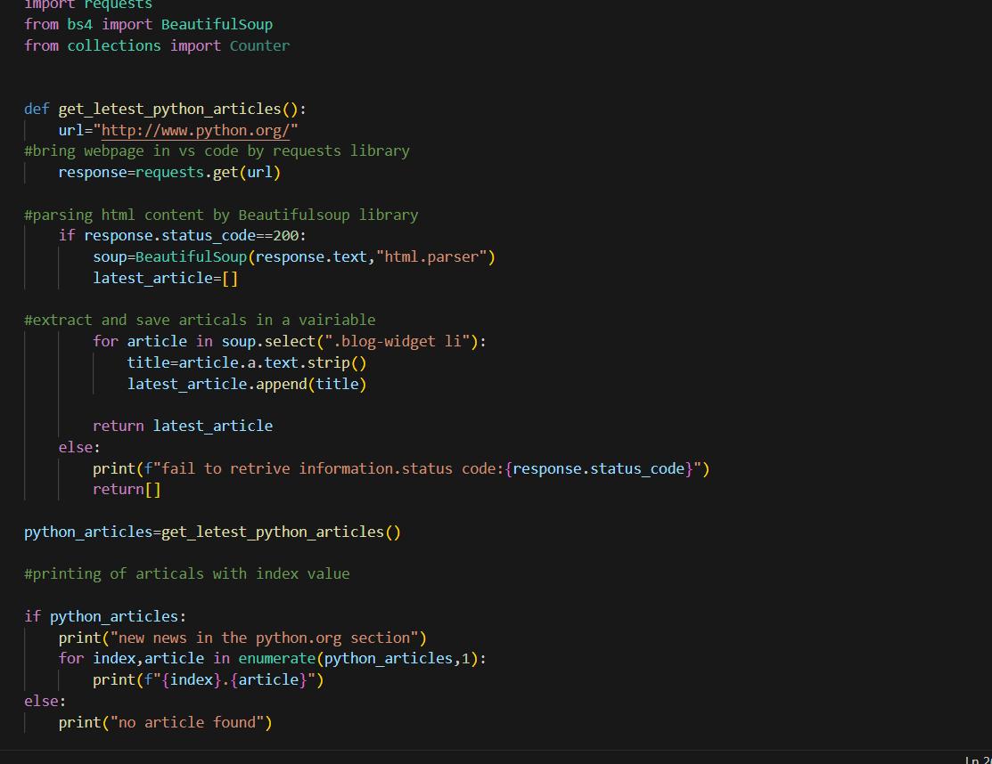
FIND THE TEXT IN URL

Slide 4
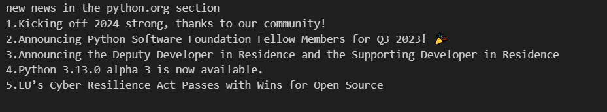
TEXT

Slide 5
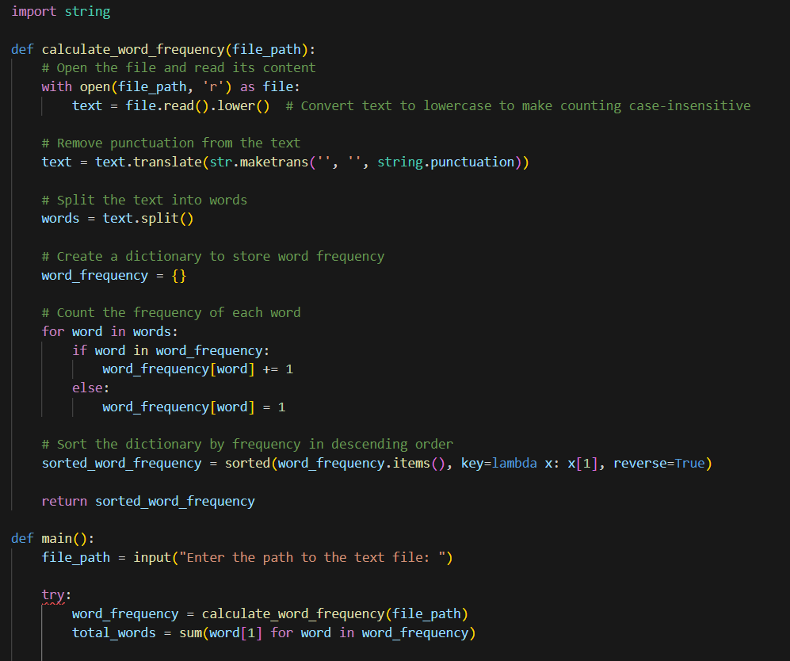
FIND THE WORD FREQUENCY IN TEXT FILE

Slide 6
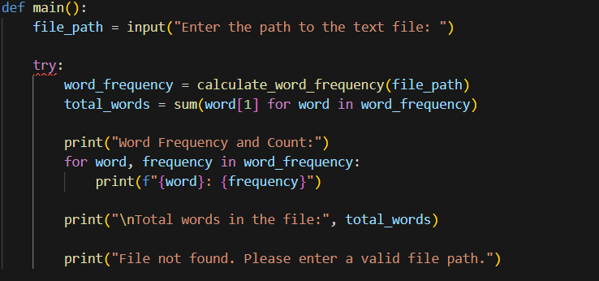
WORD FREQUENCY STEP-2

Slide 7
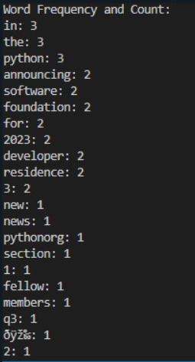
WORD FREQUENCY RESULT

